Slide 1

ERP System
Team MembersAdam MohamedYoussef EbrahimAfnan SayedHeba GadTerevena Reda
Group ID: GIZ3_SWD5_S3
Under Supervision Of: Eng. Fathi Ahmed

Slide 2

ERP System Overview & Team Roles
Welcome to our comprehensive overview of the Enterprise Resource Planning (ERP) system that powers our operations. This presentation details the essential modules and outlines the critical roles each team member plays in optimizing our business processes.

Slide 3

What is an ERP System?
Unified Platform
Streamlined Operations
An ERP system is a centralized software solution that integrates core business functions, breaking down data silos across departments.
It streamlines complex workflows, automates tasks, improves data accuracy, and significantly boosts overall operational efficiency.
Specialized Modules
Comprised of various specialized modules, our ERP is tailored to meet specific business needs, from finance to supply chain management.

Slide 4
System Architecture
API Project (Backend Services)
MVC Project (Frontend Client)
Organized into three independent layers:
1) UI/Presentation Layer: Views (Razor pages) 2) Controllers: Uses HttpClient to talk to API project3) View Models: Maps API responses → UI format
1) API Layer: Handles HTTP requests & responses2) Application Layer: Contains business logic and Coordinates operations between API & Data Access3) Data Access Layer: Entity Framework Core & migrations

Slide 5


Heba’s Modules: User, Supplier & Customer Management
User Management
Ensuring system integrity by controlling user access, defining roles, and maintaining robust security protocols for all ERP users. This module is vital for data protection and operational compliance.
Suppliers Management
This module tracks comprehensive supplier data, manages contracts, and monitors performance to foster strong, reliable supply chain relationships.
Customers Management
Oversees customer profiles, tracks orders, and manages all interactions, enhancing customer satisfaction and driving retention.
Heba's modules are the backbone of our external and internal relationship management.

Slide 6

Youssef’s Modules: Financial Management
Financial Management
This critical role involves overseeing budgeting, forecasting, managing cash flow, and generating insightful financial reports, empowering strategic decision-making.

Slide 7
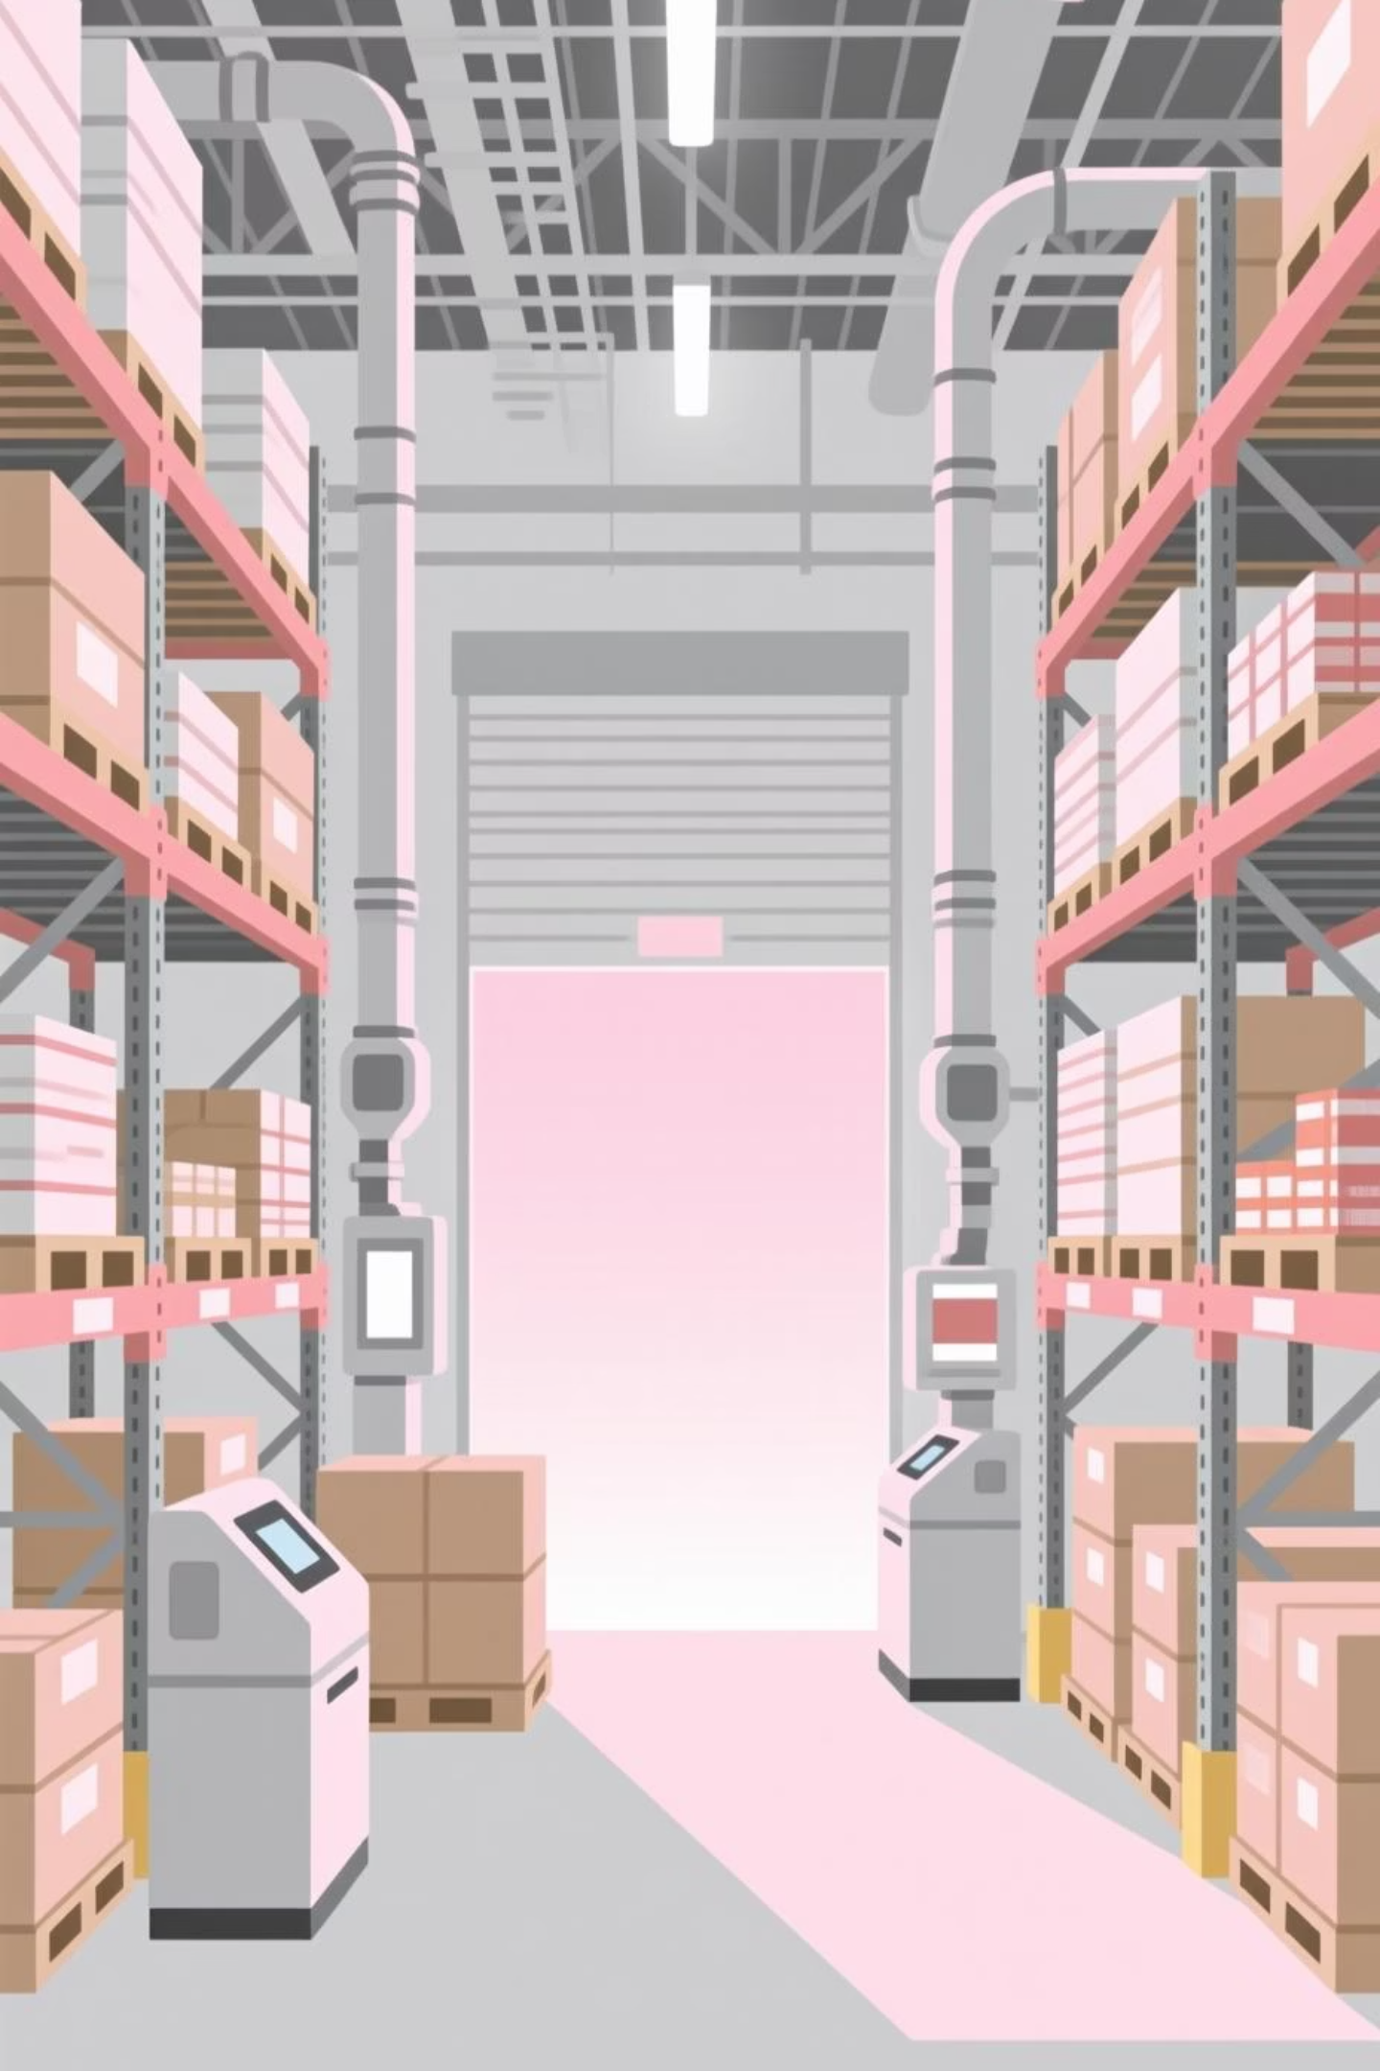

Adam’s Modules: Product, Warehouse & Inventory Adjustments
Product Management
Meticulously catalogs products, their specifications, and manages their entire lifecycle from creation to discontinuation within the system.
Warehouse Management
This module coordinates efficient storage solutions, optimizes picking processes, and streamlines shipping logistics for all products.
Inventory Adjustments
Tracking all stock changes, resolves discrepancies, and conducts regular audits to maintain precise inventory levels and prevent losses.

Slide 8


Afnan’s Modules: Purchasing & Sales
Purchasing Management
Sales Management
Managing all purchase orders, facilitates approval workflows, and cultivates strong supplier relationships to ensure timely and cost-effective procurement.
This module oversees sales orders, manages pricing strategies, and ensures efficient customer fulfillment, driving revenue and market presence.
Afnan's role connects market demand with supply, providing actionable insights through data.

Slide 9

Terevena’s Role: Frontend Development
Intuitive Interfaces
Seamless Experience
Designed and maintained user-friendly ERP interfaces, ensuring that all team members can easily interact with the system.
Focusing on user experience, Terevena ensures smooth navigation and efficient functionality across all modules, from input to output.
Backend-to-User Bridge
Terevena acts as the crucial link between the ERP's technical backend and the end-user, making complex systems accessible and understandable.

Slide 10

THANK YOU
Any Questions?

